Slide 1
Advanced Artificial Intelligence
Week #6
Dr. Qurat Ul Ain
Assistant Professor Dept. of AI & DS
FAST NUCES, Islamabad
Email: quratul.ain@isb.nu.edu.pk

Slide 2
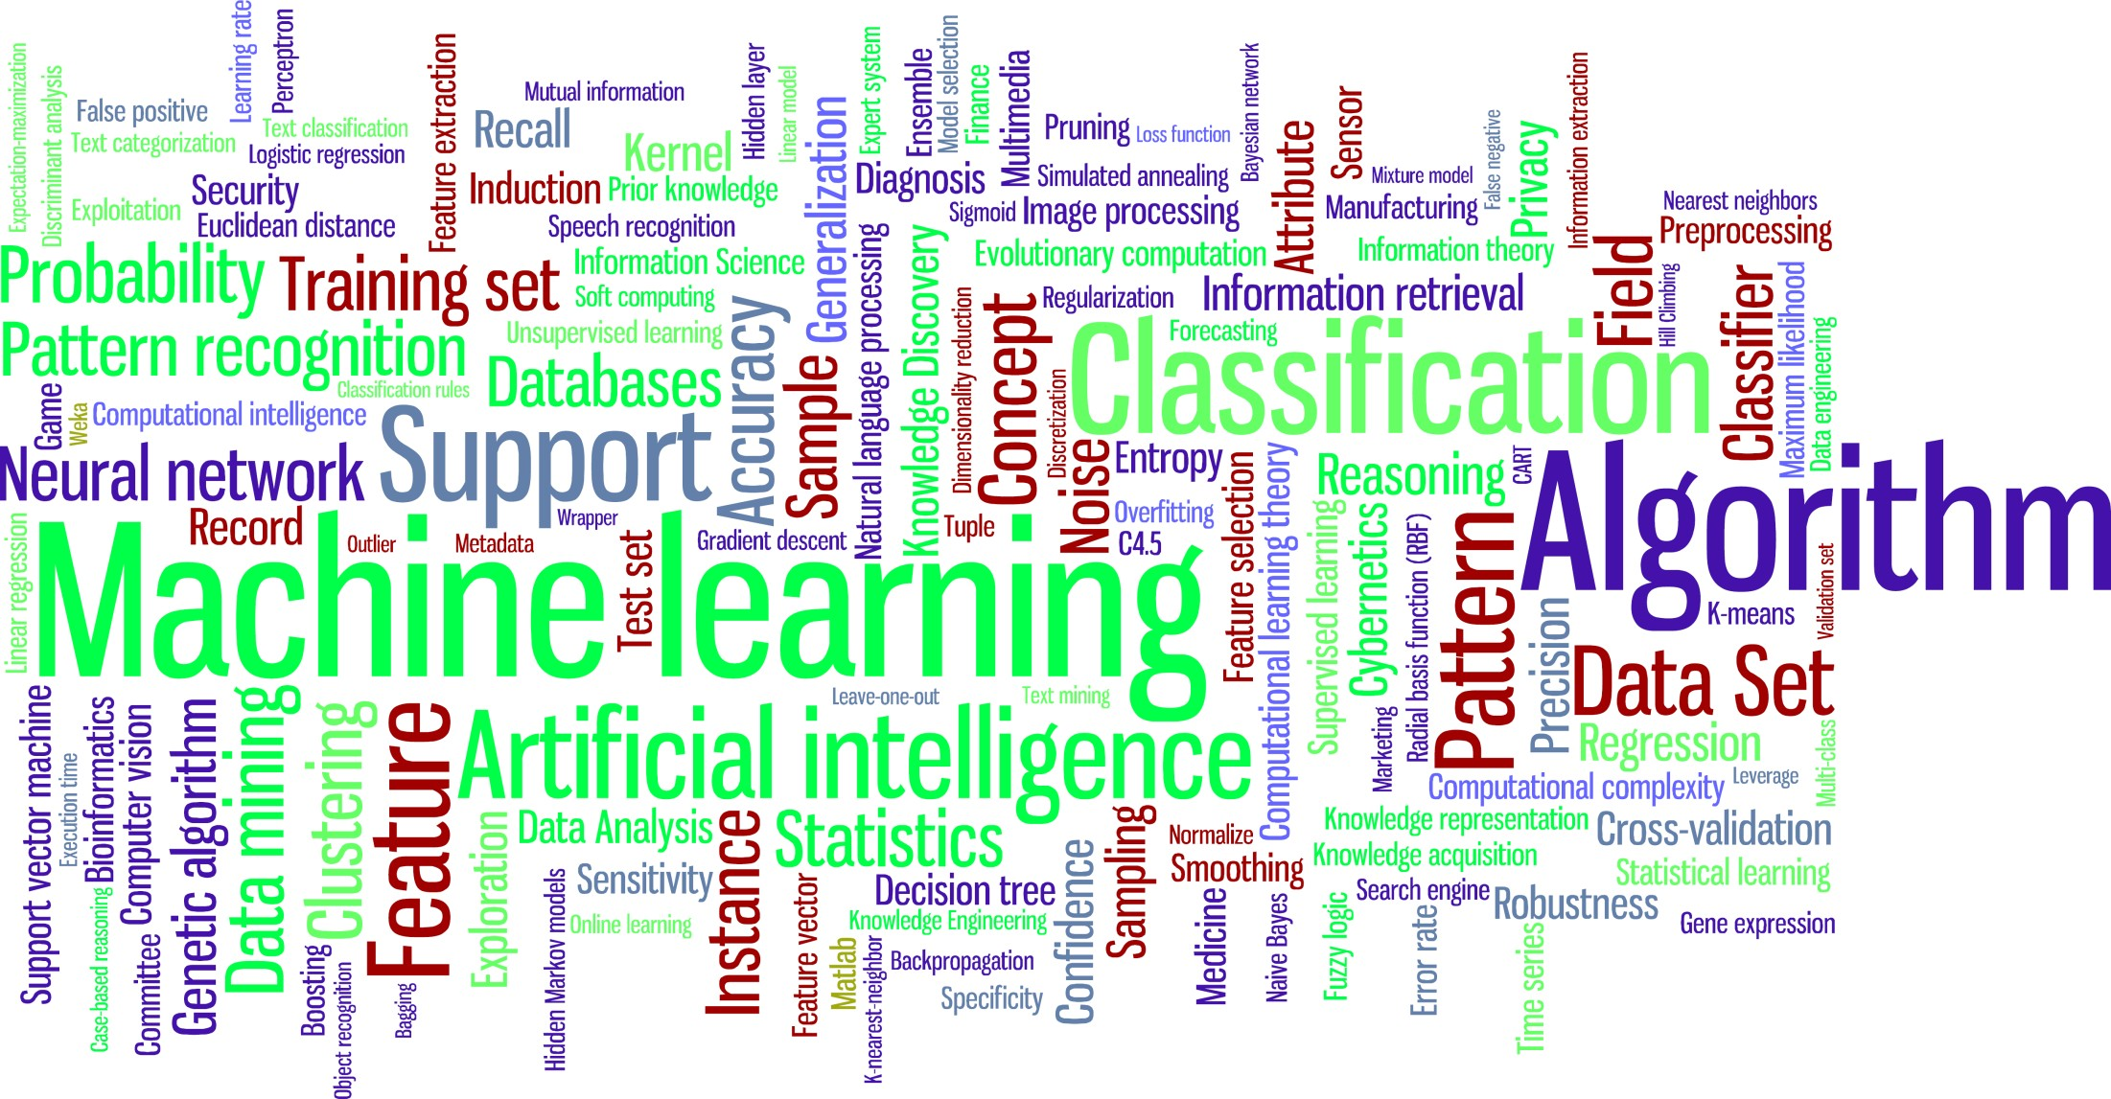
Course Information
3
Course Name: Machine Learning

Slide 3
Regression-I
Problem Overview
Regression
Model Representation
Cost Function
Gradient Descent
Gradient Descent for Linear Regression

Slide 4

Problem
What should I watch this Friday?

Slide 5
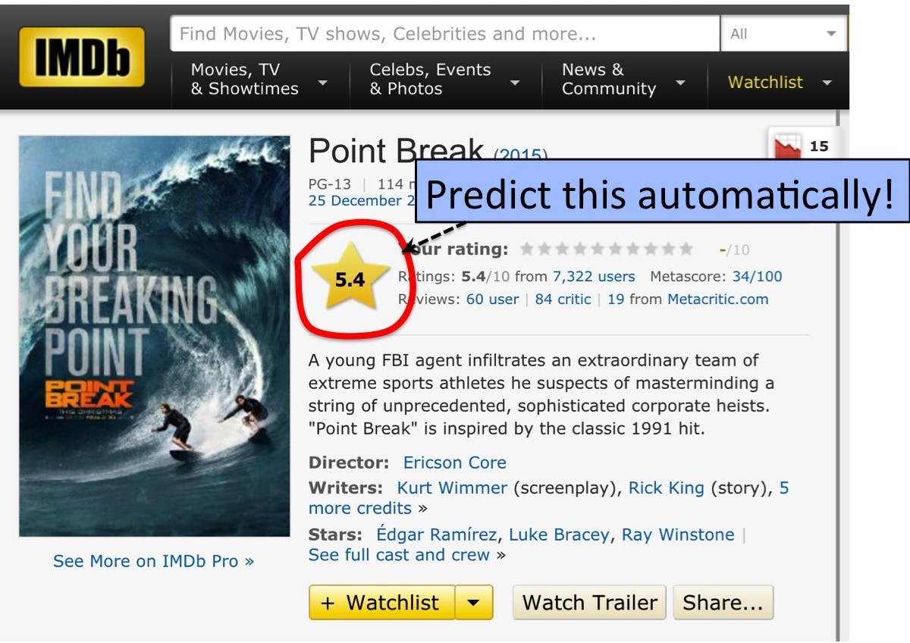
Problem
Goal: Predict movie rating automatically!

Slide 6
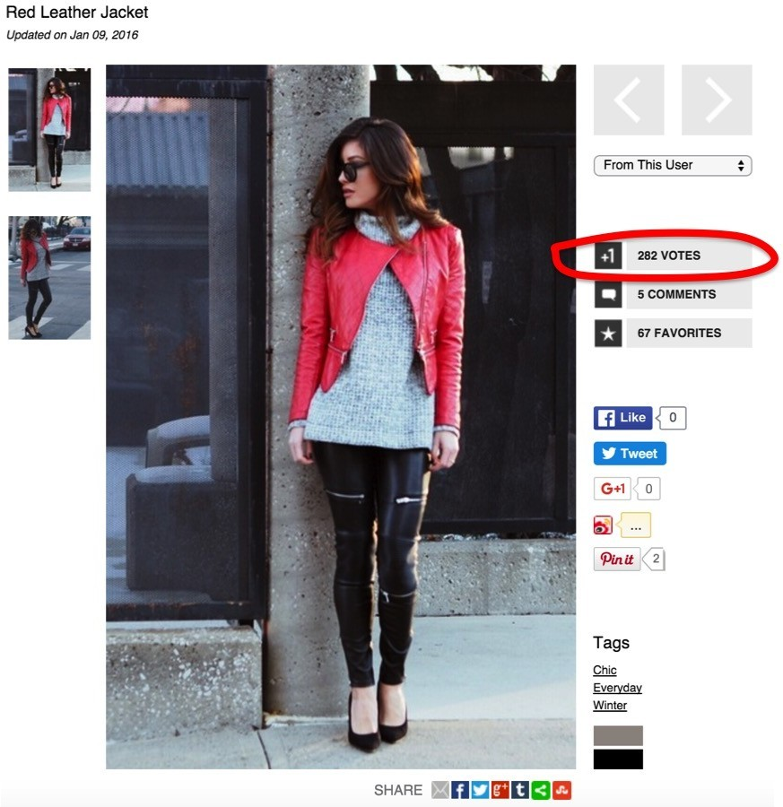
Problem
Goal: How many followers will I get?

Slide 7
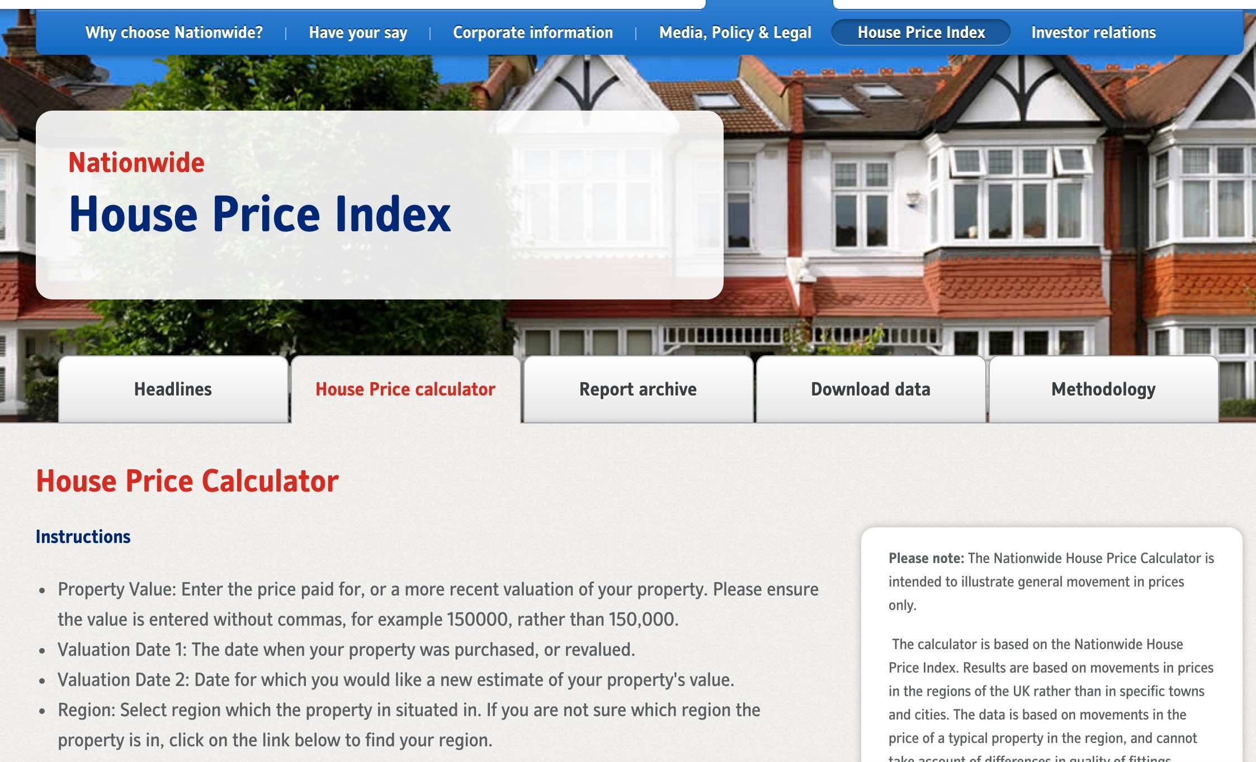
Problem
Goal: Predict the price of house

Slide 8
Regression
What do all these problems have in common?
Continuous outputs, we’ll call these y
(e.g., a rating: a real number between 0-10, # of followers, house price)
Predicting continuous outputs is called regression
What do I need in order to predict these outputs?
Features (inputs), we’ll call these x (or x if vectors)
Training examples, many x^{(i)} for which y^{(i)} is known (e.g., many movies for which we know the rating)
A model, a function that represents the relationship between x and y
A loss or a cost or an objective function, which tells us how well our model approximates the training examples
Optimization, a way of finding the parameters of our model that minimizes the loss function

Slide 9
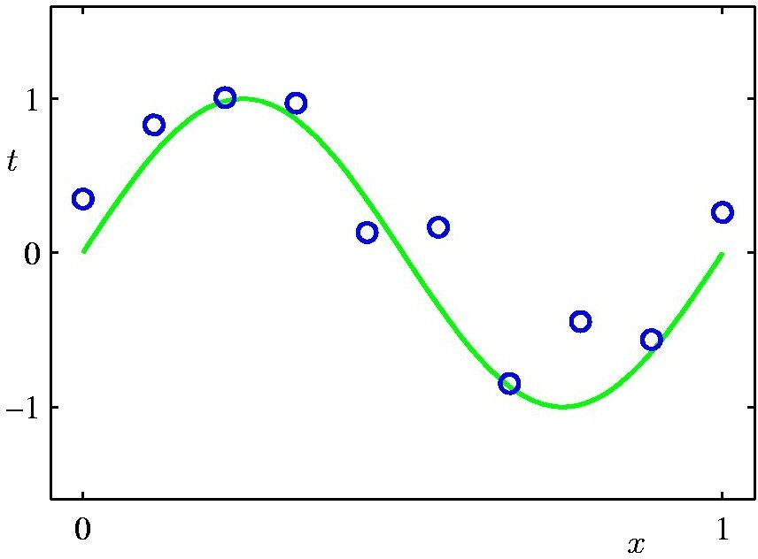
Simple 1-D regression
Circles are data points (i.e., training examples) that are given to us.
y(x) = h (x ) + ϵ, with ϵ some noise
Green curve is the ”true” curve that we don’t know
Goal: We want to fit a curve to these points

Slide 10

Linear regression with one variable
Model representation
Machine Learning

Slide 11
Model Representation
Housing Prices (Portland, OR)
Price (in 1000s of dollars)
500
400
300
200
100
0
0
500 1000 1500 2000 2500 3000
Size (feet²)
Regression Problem
Predict real-valued output
Supervised Learning
Given the “right answer” for each example in the data.

Slide 12
Model Representation
Training set of housing prices (Portland, OR)
Size in feet² (x) | Price ($) in 1000's (y)
2104 | 460
1416 | 232
1534 | 315
852 | 178
… | …
Notation:
m = Number of training examples
x’s = “input” variable / features
y’s = “output” variable / “target” variable

Slide 13
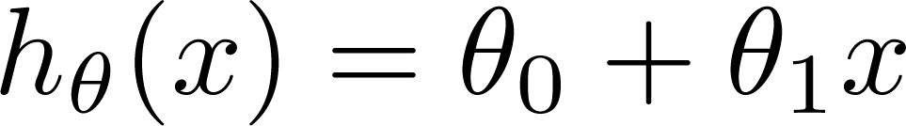
Model Representation
Training Set
How do we represent h ?
Learning Algorithm
Size of house
h
Estimated price
h maps from x to y
Linear regression with one variable. Univariate linear regression.

Slide 14
Linear regression with one variable
Cost function
Machine Learning

Slide 15

Cost Function
Training Set
Size in feet² (x) | Price ($) in 1000's (y)
2104 | 460
1416 | 232
1534 | 315
852 | 178
… | …
Hypothesis:
‘s: Parameters How to choose ‘s ?

Slide 16
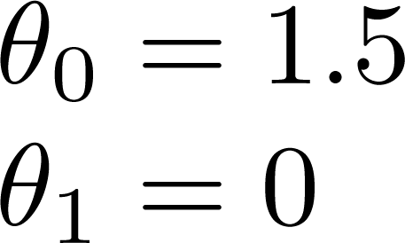
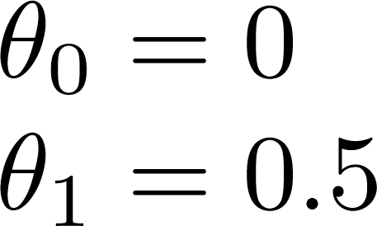
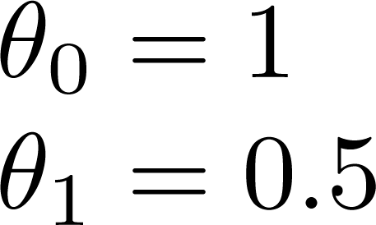
Cost Function
3
2
1
0
3
2
1
0
3
2
1
0
0
1
2
3
0
1
2
3
0
1
2
3

Slide 17
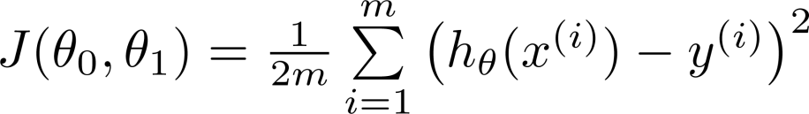
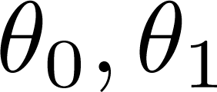


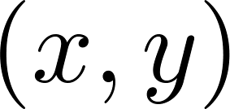
Cost Function
Cost Function:
y
x
Idea: Choose so that
is close to for our training examples

Slide 18
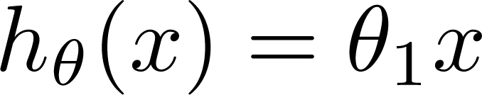

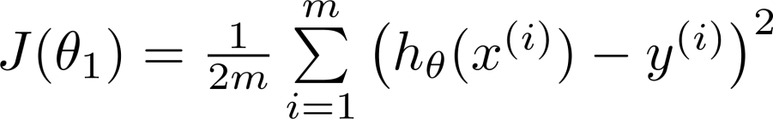
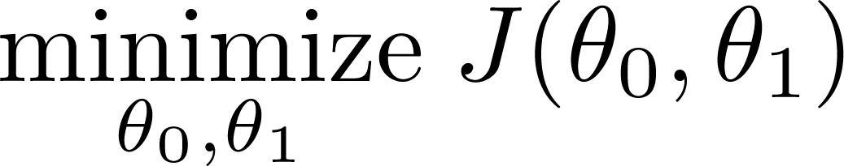
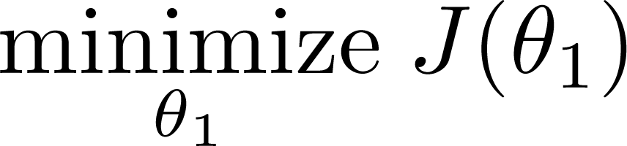
Cost Function
Simplified
Hypothesis:
Parameters:
y
y
Cost Function:
x
x
Goal:

Slide 19
Linear regression with one variable
Cost function intuition II
Machine Learning

Slide 20
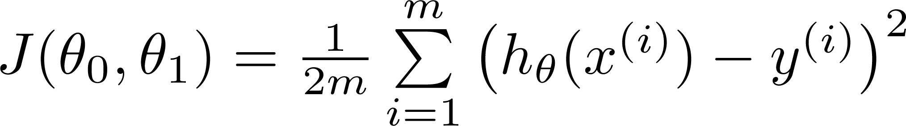
Linear Regression
Hypothesis:
Parameters: Cost Function: Goal:

Slide 21
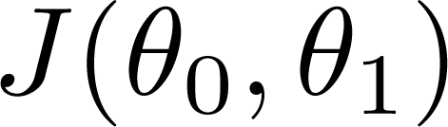



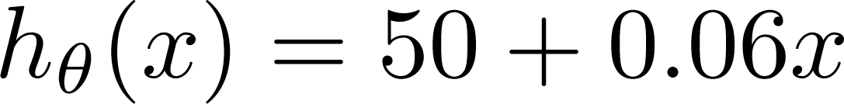
Cost Function
(for fixed
, this is a function of x)
(function of the parameters
)
500
400
300
200
100
Price ($) in 1000’s
0
0
1000 2000
Size in feet² (x)
3000

Slide 22
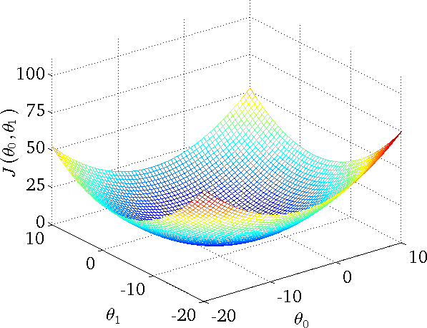
Cost Function

Slide 23
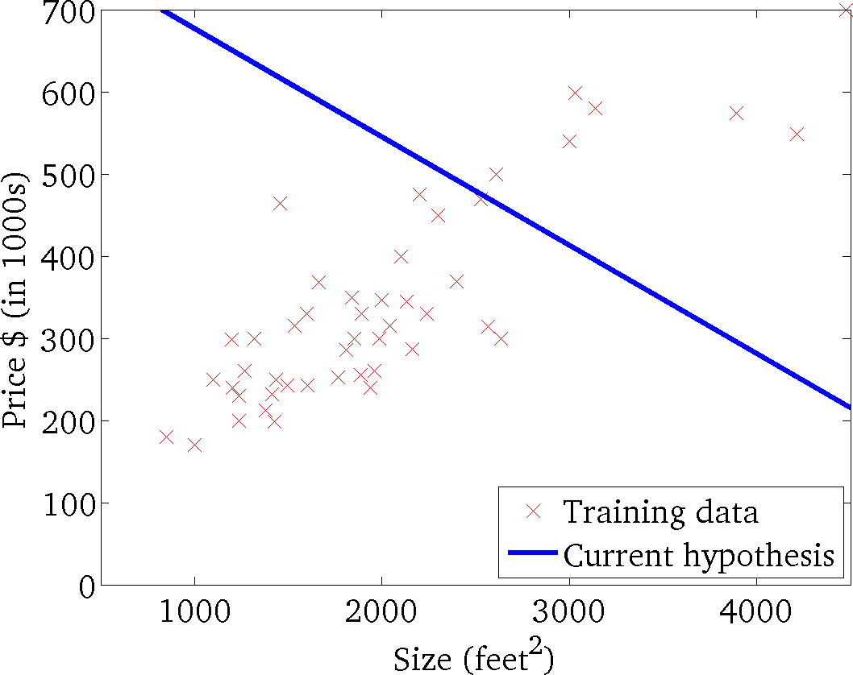
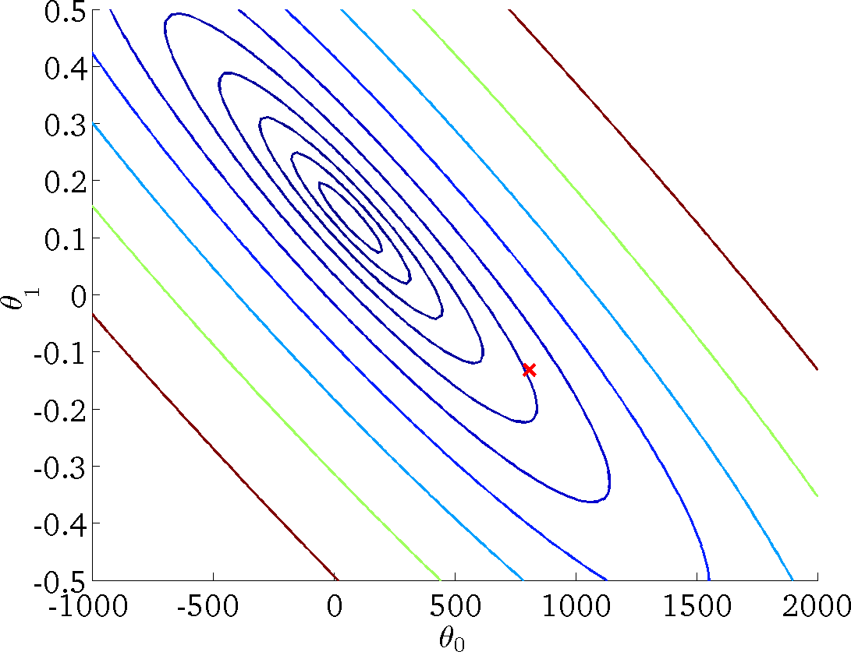
Cost Function
(for fixed
, this is a function of x)
(function of the parameters
)

Slide 24
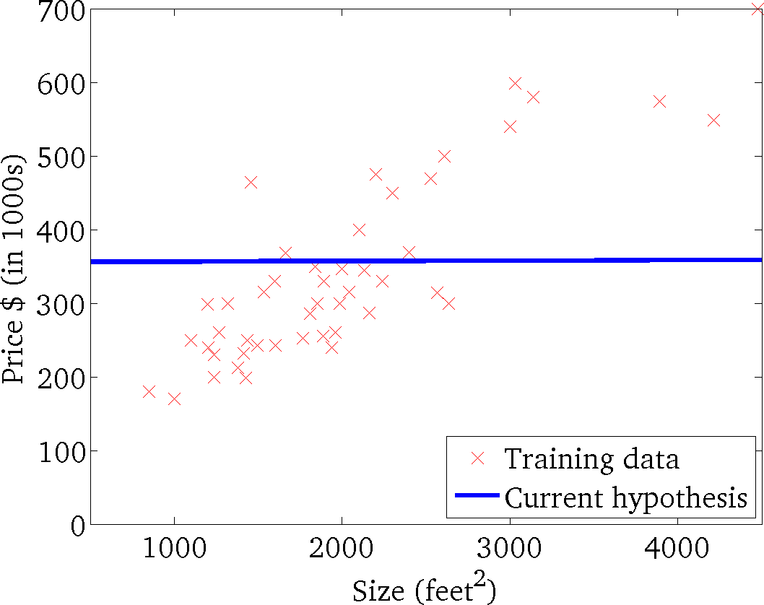
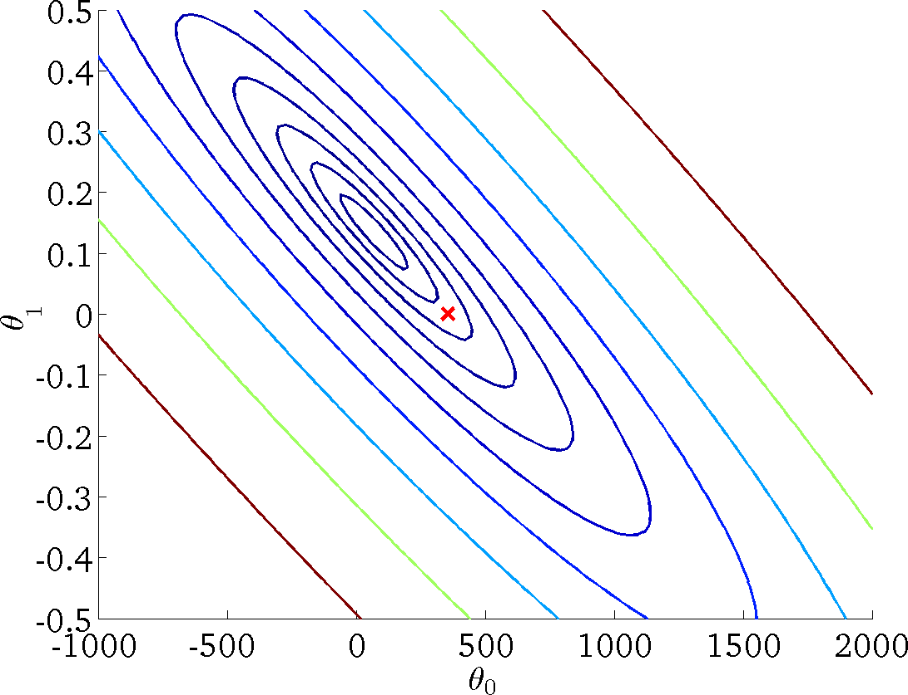
Cost Function
(for fixed
, this is a function of x)
(function of the parameters
)

Slide 25
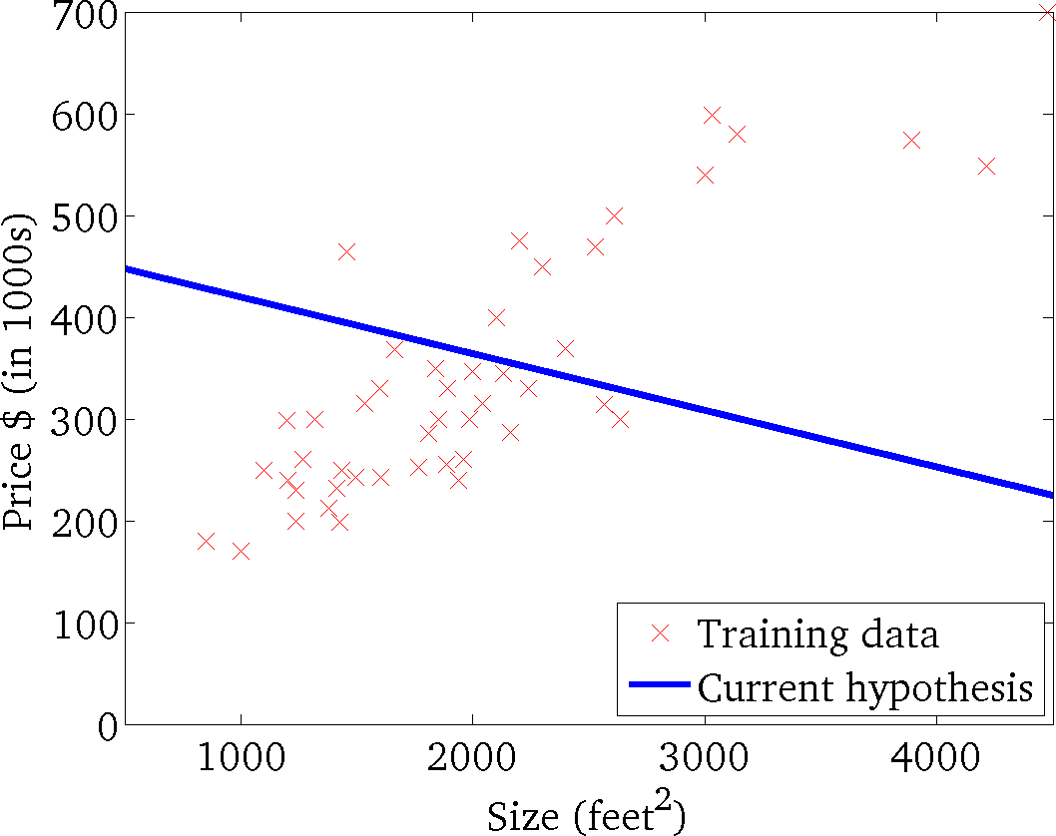

Cost Function
(for fixed
, this is a function of x)
(function of the parameters
)

Slide 26
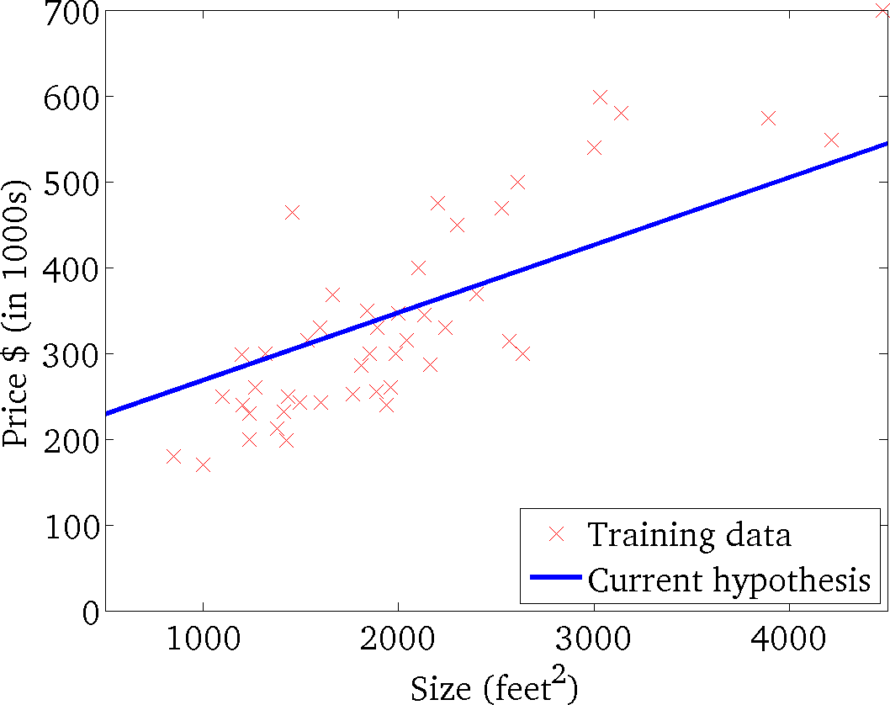
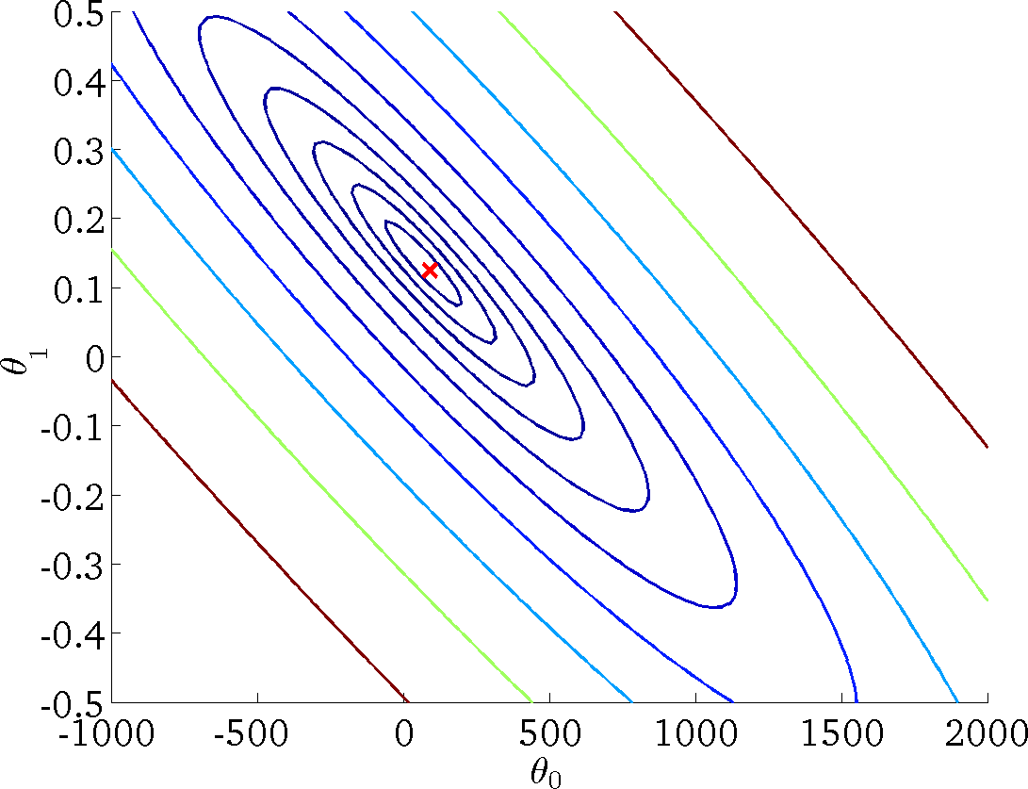
Cost Function
(for fixed
, this is a function of x)
(function of the parameters
)

Slide 27
Linear regression with one variable
Gradient descent
Machine Learning

Slide 28
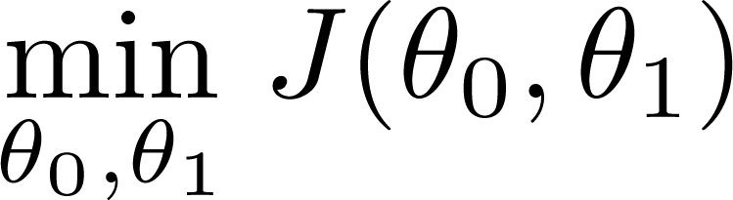
Gradient descent algorithm
Have some function Want
Outline:
Start with some
Keep changing
to reduce
until we hopefully end up at a minimum

Slide 29
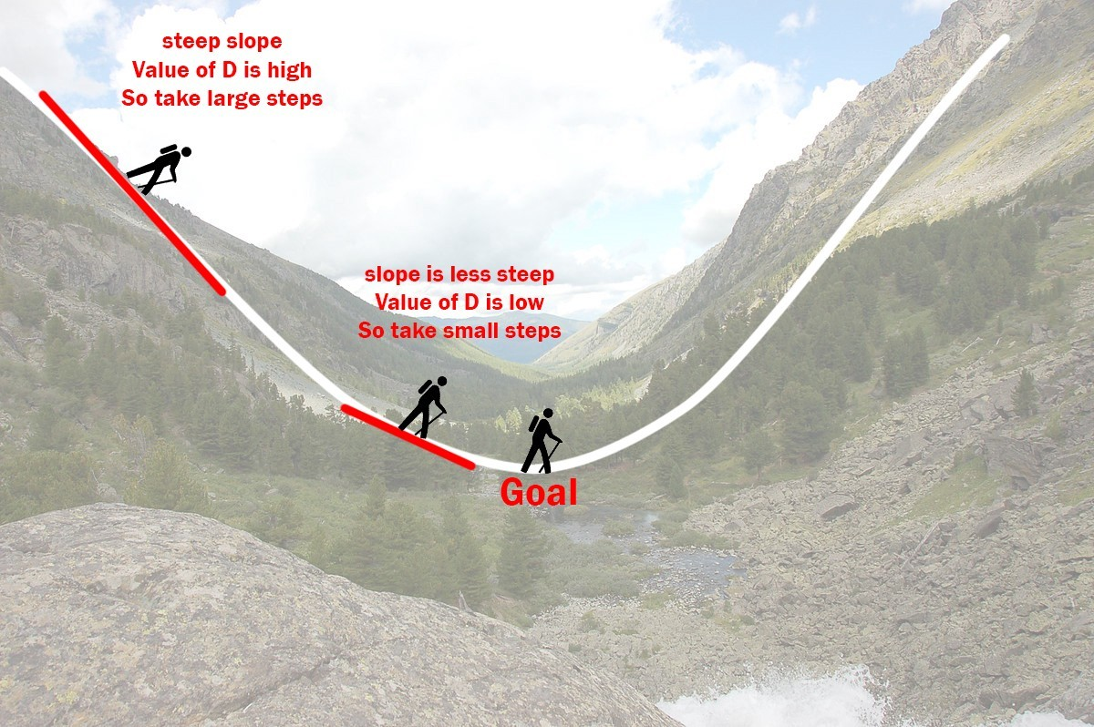
Gradient descent
Gradient descent is an iterative optimization algorithm to find the minimum of a function. Here that function is our Loss Function.
Imagine a valley and a person with no sense of direction who wants to get to the bottom of the valley. He goes down the slope and takes large steps when the slope is steep and small steps when the slope is less steep. He decides his next position based on his current position and stops when he gets to the bottom of the valley which was his goal.

Slide 30
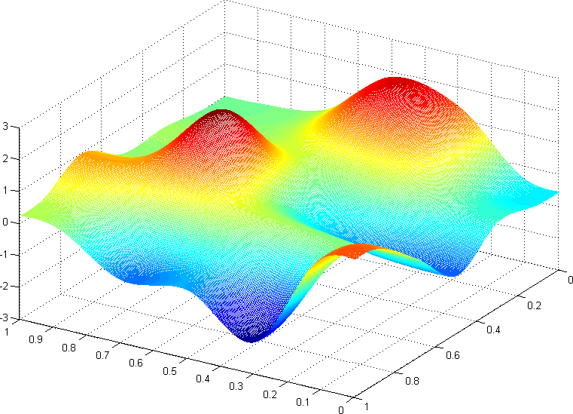


Gradient descent algorithm
J(θ₀,θ₁)
θ₁
θ₀

Slide 31
Gradient descent algorithm
J(θ₀,θ₁)
θ₁
θ₀

Slide 32
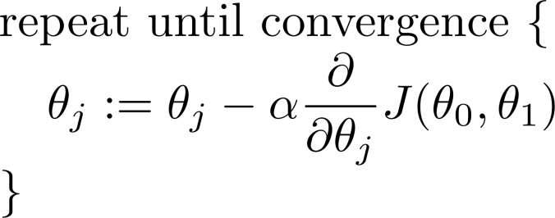
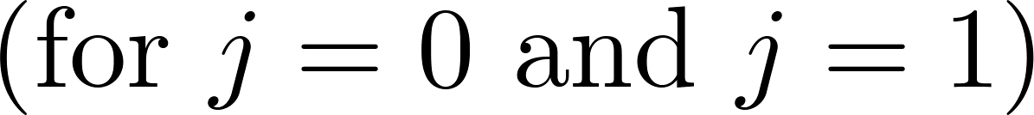
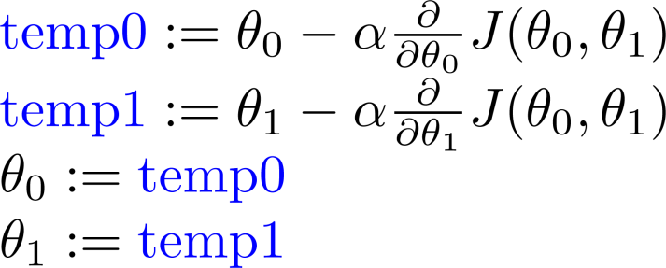
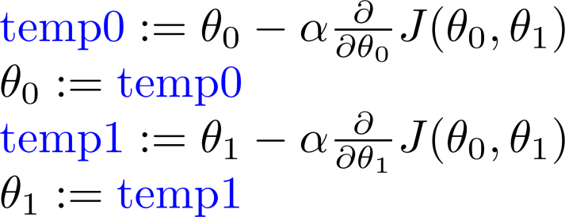
Gradient descent algorithm
Correct: Simultaneous update
Incorrect:

Slide 33
Linear regression with one variable
Gradient descent intuition
Machine Learning

Slide 34
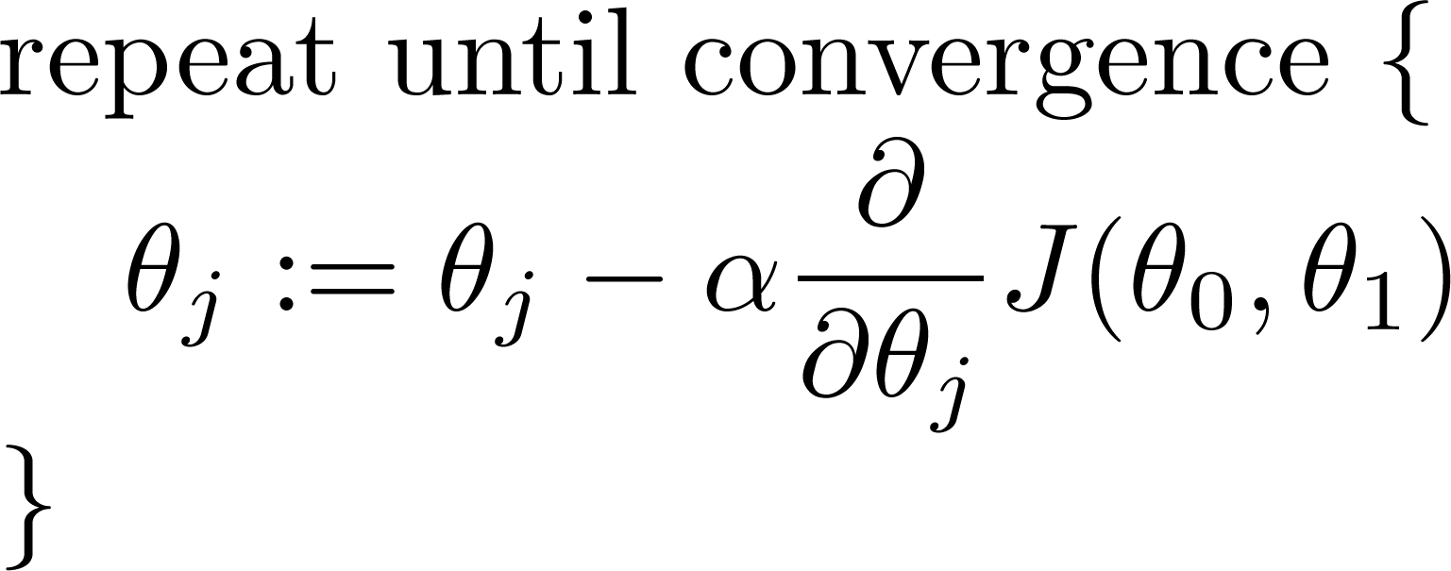
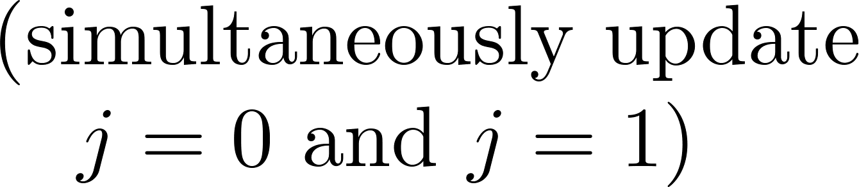
Gradient descent algorithm

Slide 35
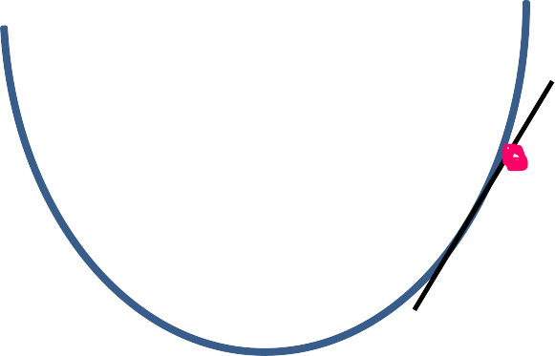

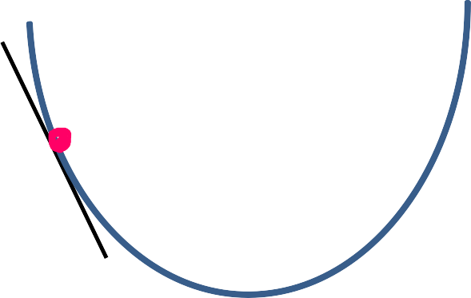

Gradient descent algorithm
𝐽(𝜃%)
𝜃%
𝐽(𝜃%)
𝜃%

Slide 36
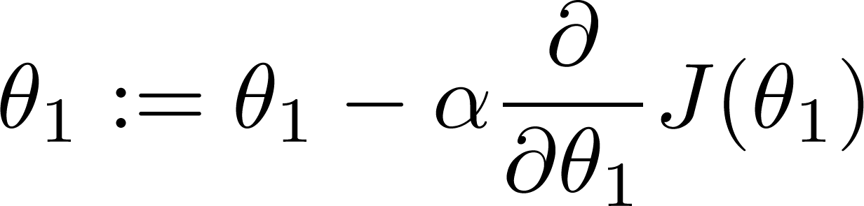
Gradient descent algorithm
If α is too small, gradient descent can be slow.
If α is too large, gradient descent can overshoot the minimum. It may fail to converge, or even diverge.

Slide 37



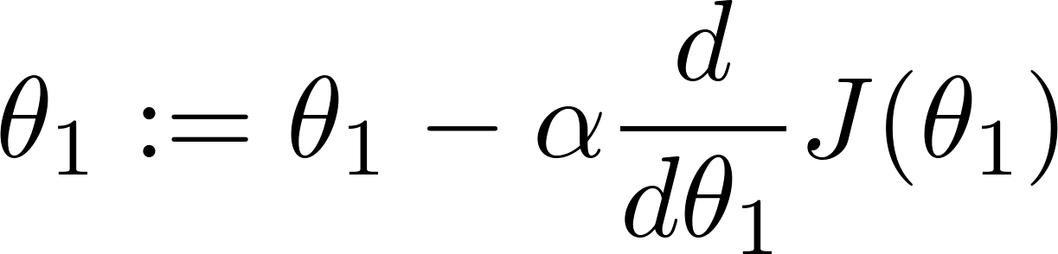

Gradient descent algorithm
Slope=0
at local optima
Current value of

Slide 38

Gradient descent algorithm
Gradient descent can converge to a local minimum, even with the learning rate α fixed.
As we approach a local minimum, gradient descent will automatically take smaller steps. So, no need to decrease α over time.

Slide 39
Linear regression with one variable
Gradient descent for linear regression
Machine Learning

Slide 40
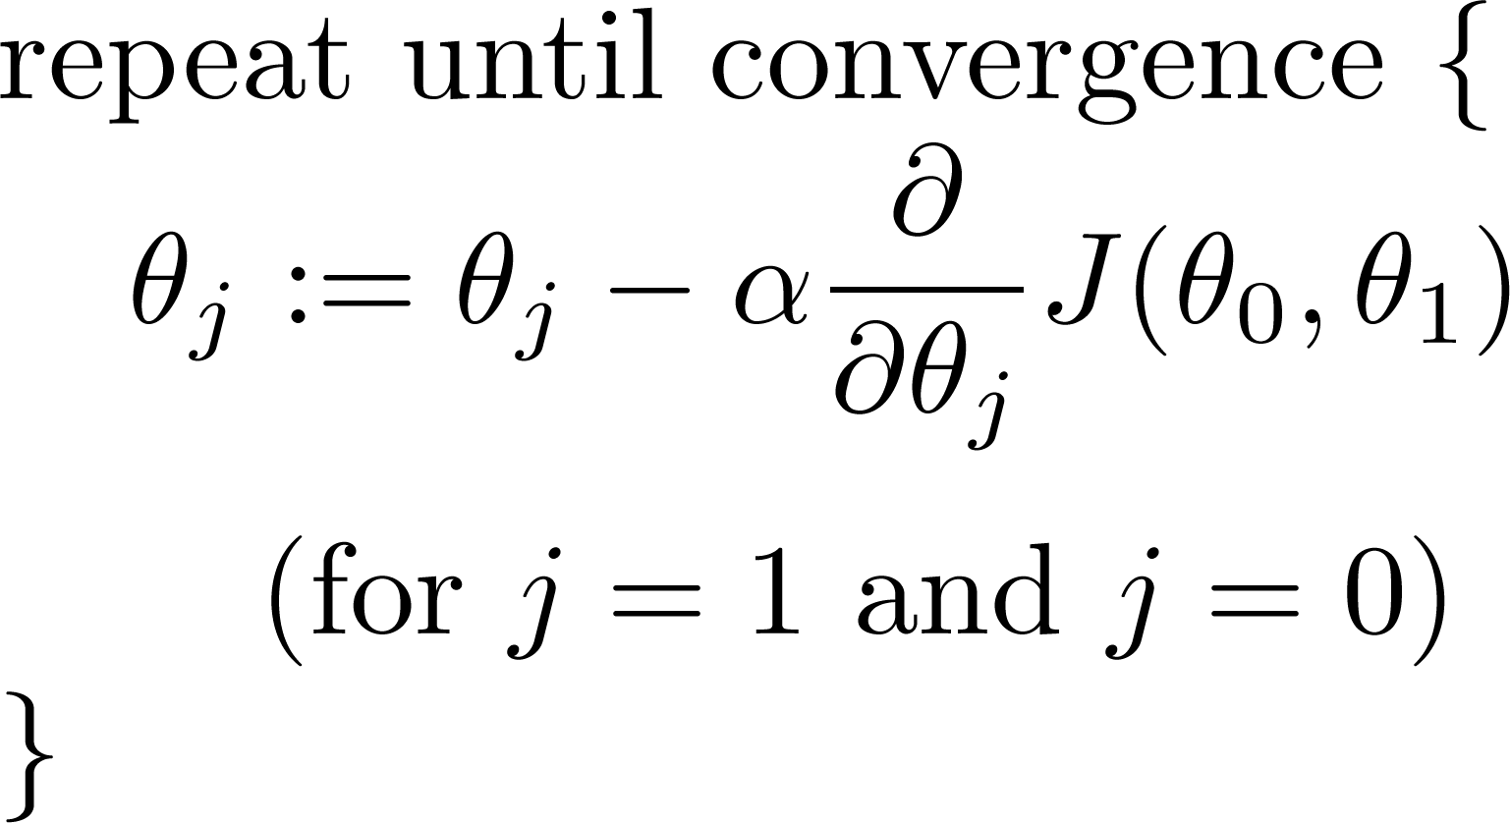
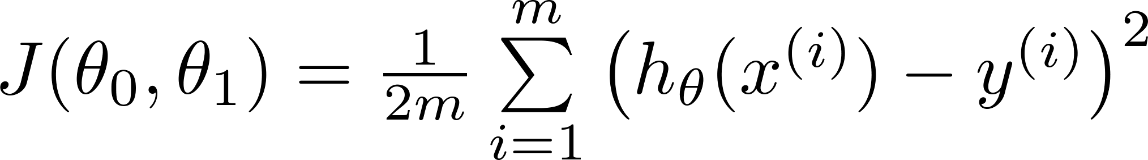
Gradient descent for linear regression
Gradient descent algorithm Linear Regression Model

Slide 41
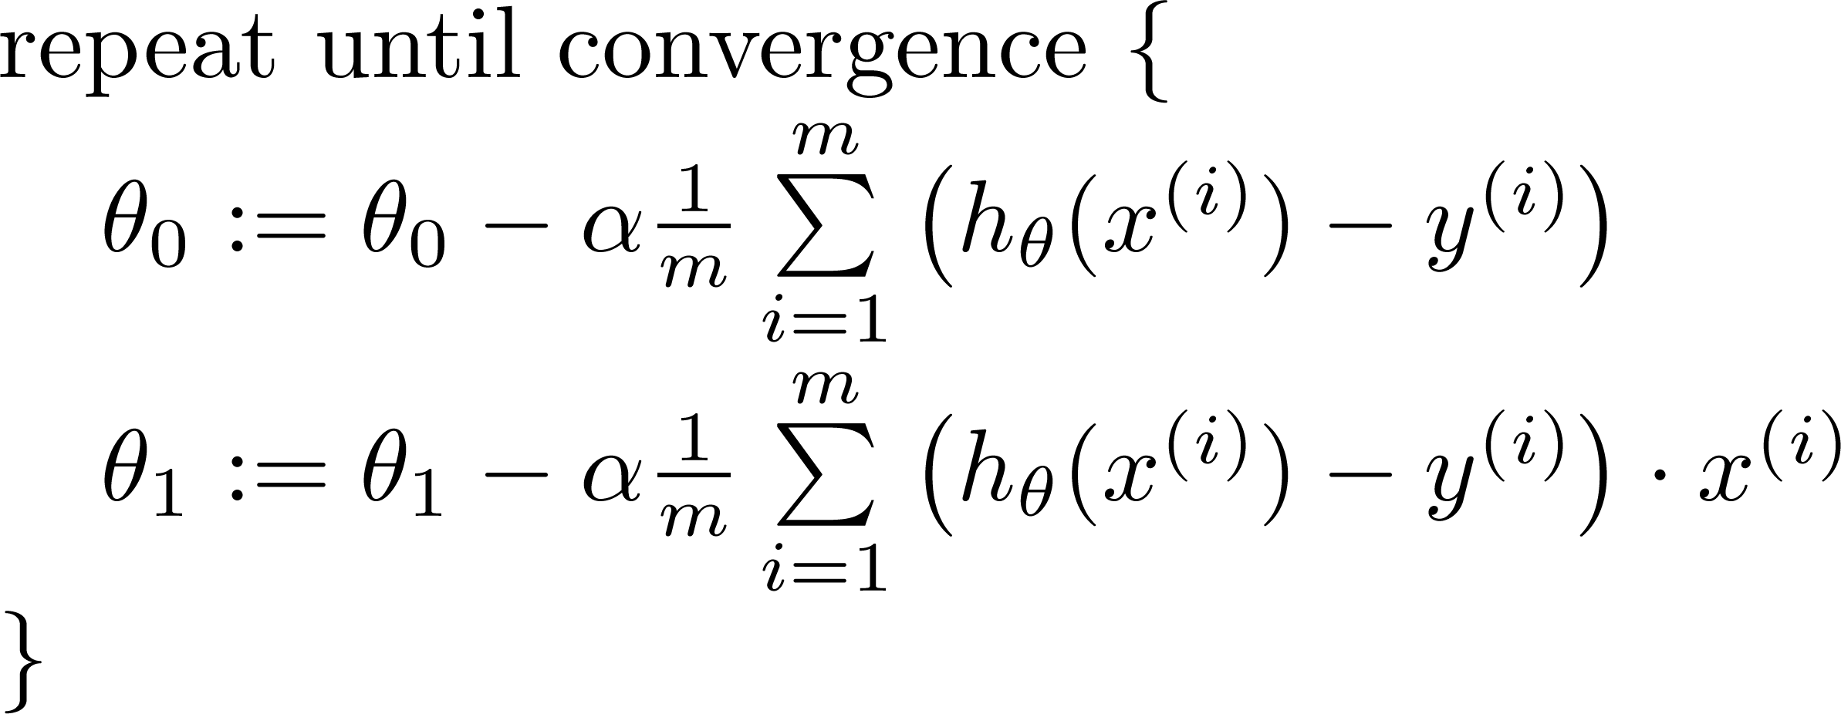

Gradient descent for linear regression
Gradient descent algorithm
update and
simultaneously

Slide 42
Gradient descent for linear regression
J(θ₀,θ₁)
θ₁
θ₀

Slide 43
Gradient descent for linear regression
θ₁
θ₀

Slide 44
Gradient descent for linear regression

Slide 45
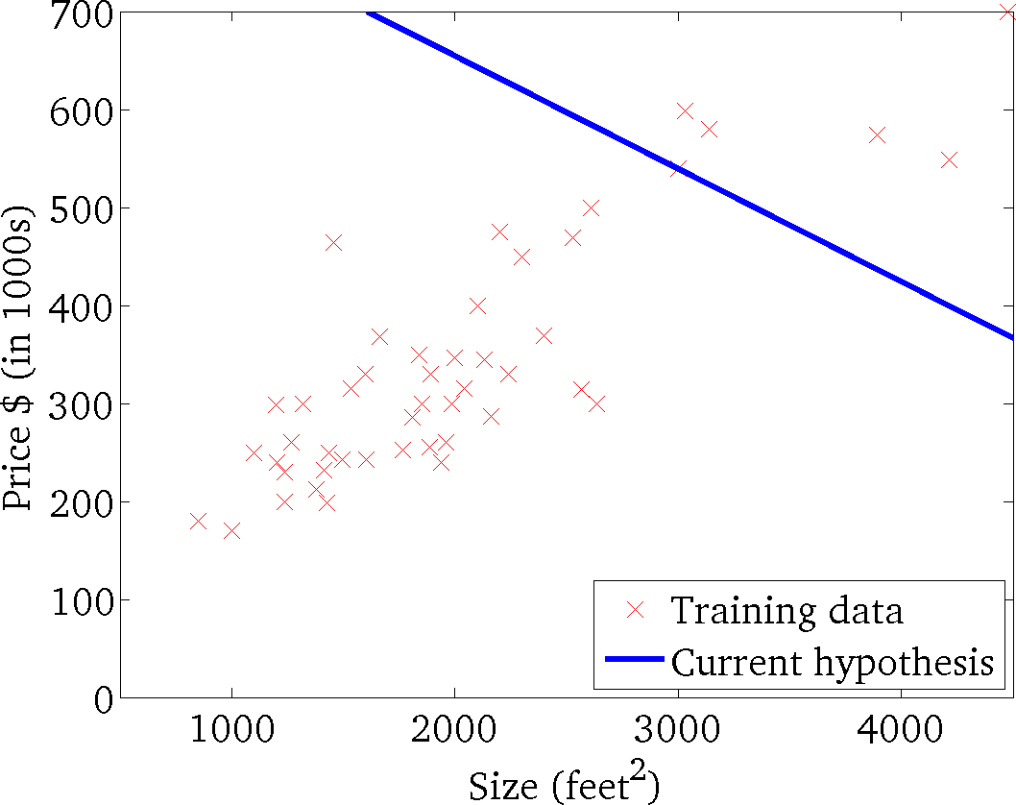
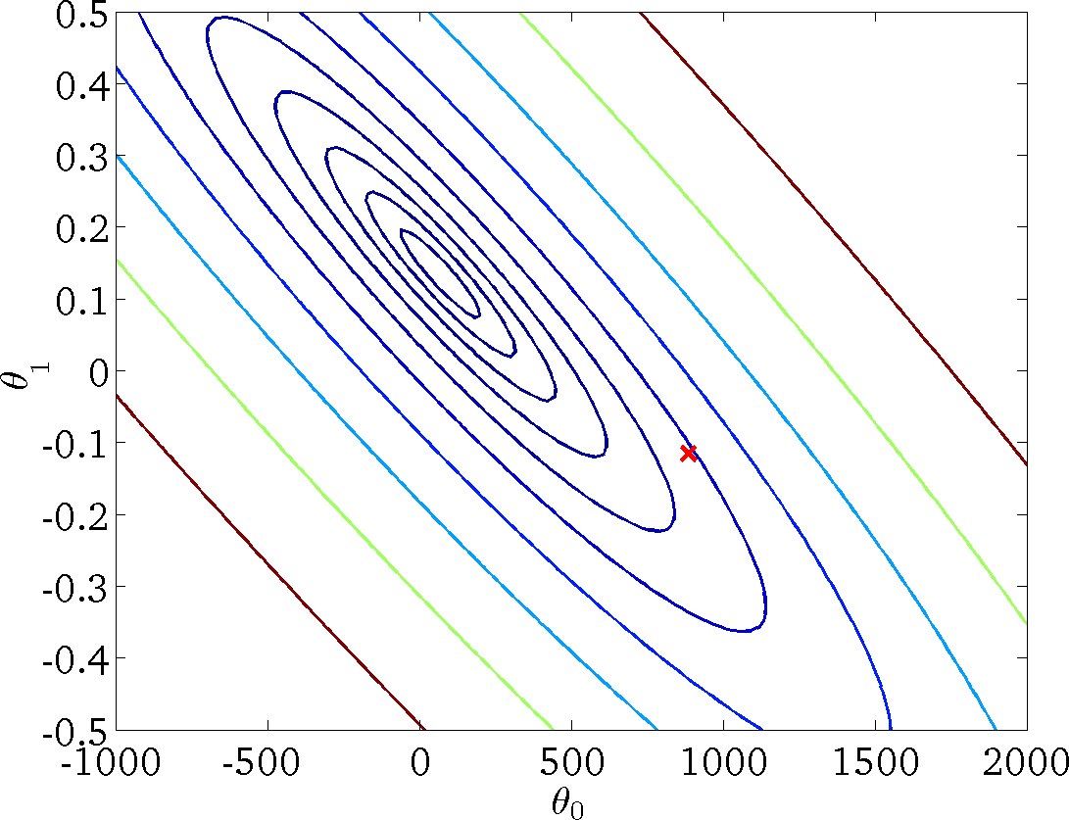
Gradient descent for linear regression
(for fixed
, this is a function of x)
(function of the parameters
)

Slide 46

Gradient descent for linear regression
(for fixed
, this is a function of x)
(function of the parameters
)

Slide 47
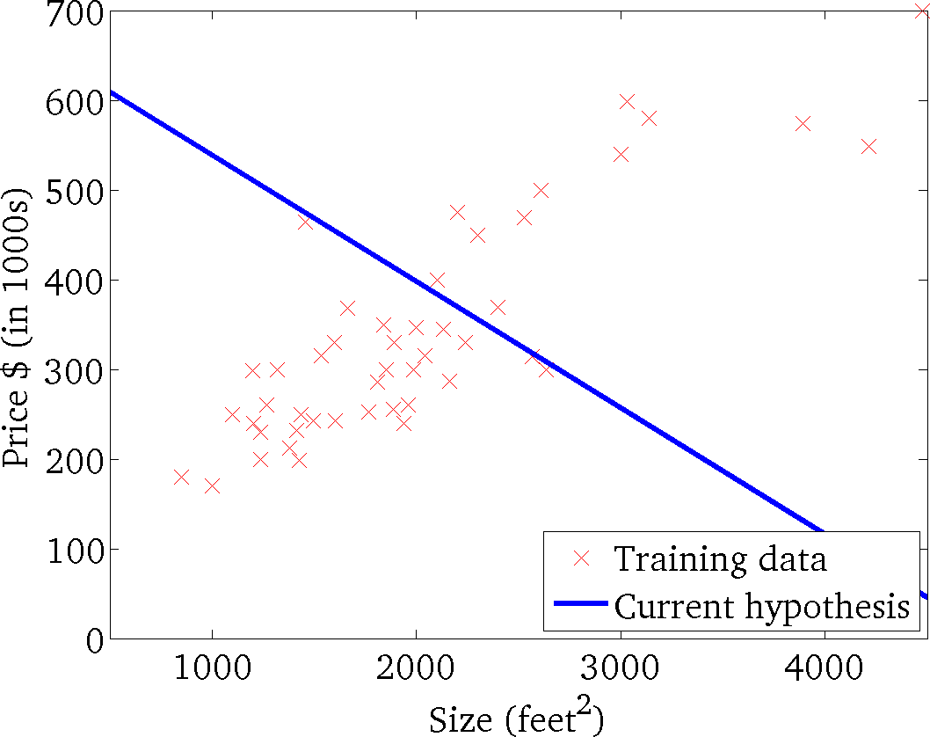

Gradient descent for linear regression
(for fixed
, this is a function of x)
(function of the parameters
)

Slide 48
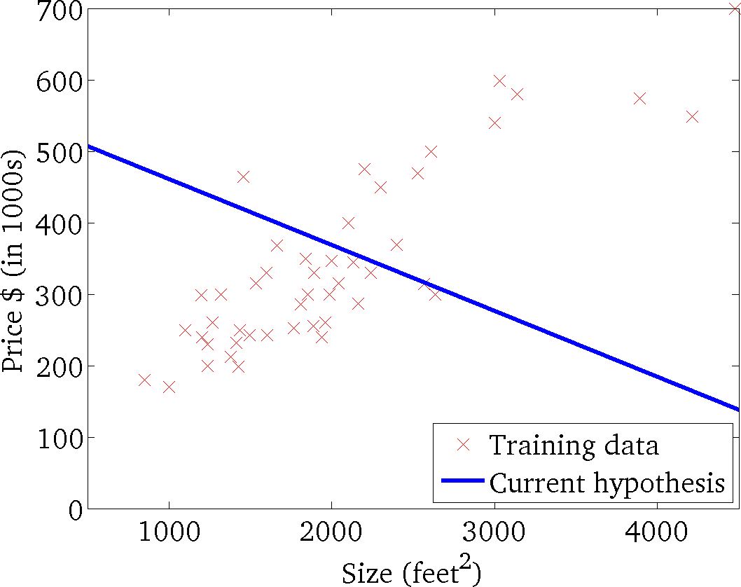
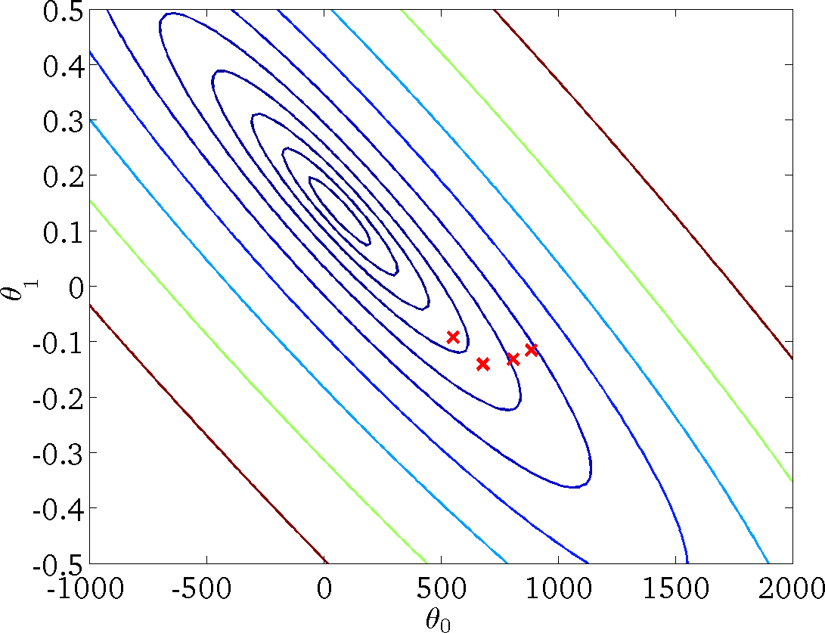
Gradient descent for linear regression
(for fixed
, this is a function of x)
(function of the parameters
)

Slide 49
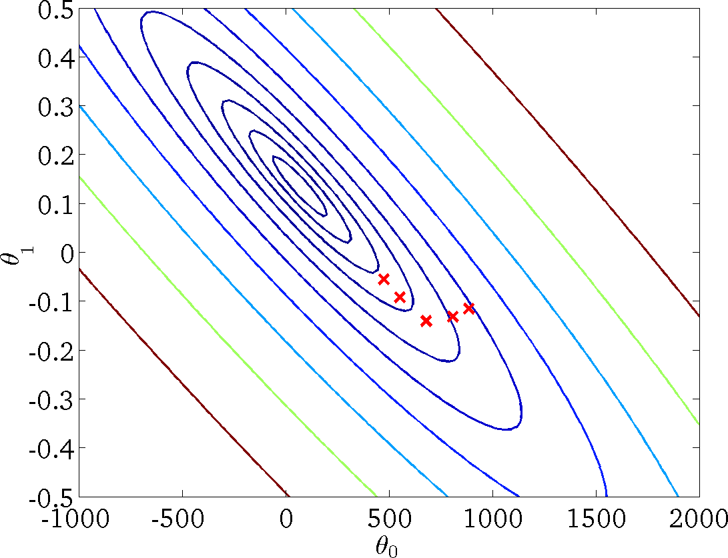
Gradient descent for linear regression
(for fixed
, this is a function of x)
(function of the parameters
)

Slide 50
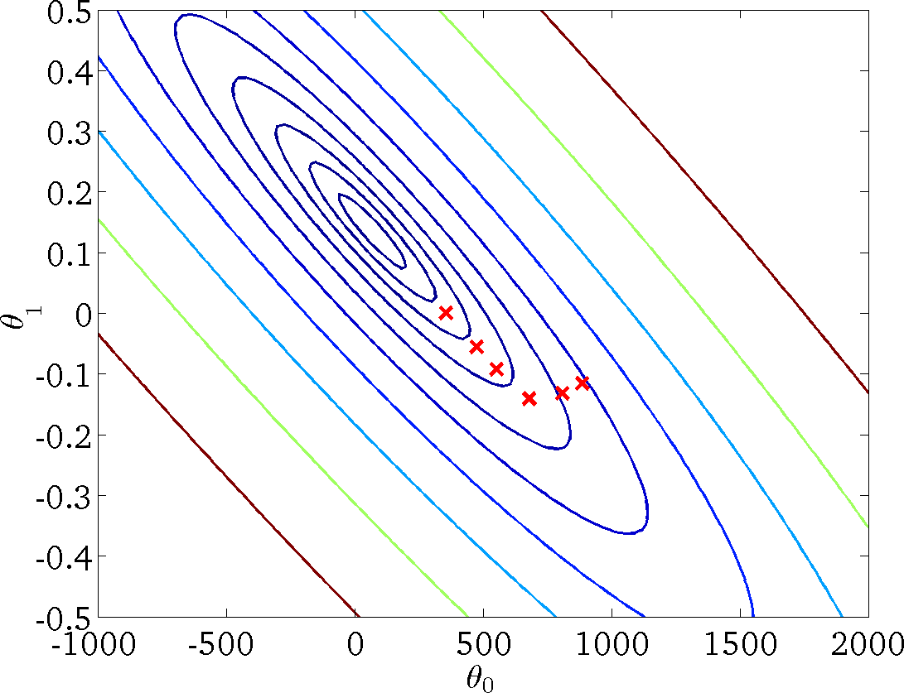
Gradient descent for linear regression
(for fixed
, this is a function of x)
(function of the parameters
)

Slide 51


Gradient descent for linear regression
(for fixed
, this is a function of x)
(function of the parameters
)

Slide 52

Gradient descent for linear regression
(for fixed
, this is a function of x)
(function of the parameters
)

Slide 53


Gradient descent for linear regression
(for fixed
, this is a function of x)
(function of the parameters
)

Slide 54


Enhancing Accuracy of Line-Following Robots with Linear Regression
Warehouse Automation: Robots transport goods along marked paths in a warehouse.
Challenge: Robots need to adjust steering to stay on track if they deviate from the line.
Position Offset: Measures how far the robot is from the center of the line (input variable).
Linear Regression Solution: Models the relationship between Position Offset and required Steering Angle.
Gradient Descent Optimization:
- Begins with initial steering predictions.
- Iteratively adjusts parameters to minimize error in steering.
Outcome: Robots learn the precise steering angle for each offset, enabling accurate, consistent line-following.

Slide 55

Enhancing Accuracy of Line-Following Robots with Linear Regression
Position Offset (x) | Steering Angle (y)
0 | 0
-0.5 | -10
-1 | -20
-1.5 | -30
1.5 | 30
1 | 20
0.5 | 10
-0.3 | -5
0.3 | 5
-1.2 | -25

Slide 56

For any query Feel Free to ask
43

